Slide 1
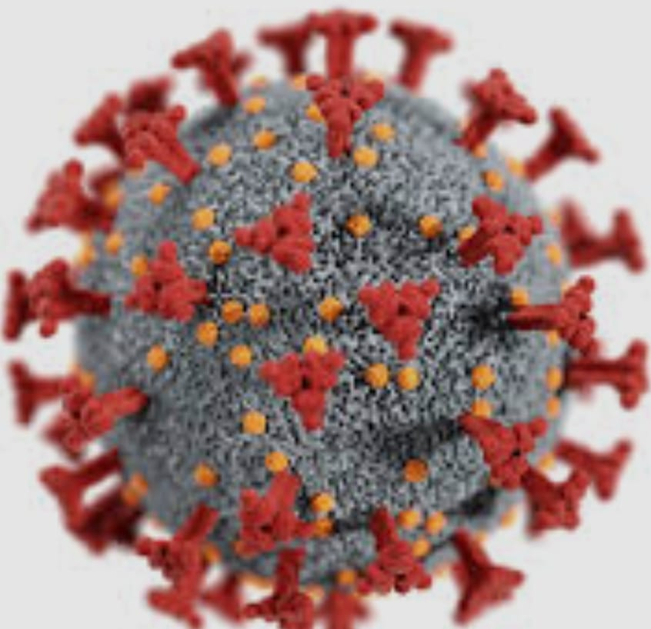
Proxenix Company Intership
GROUP NUMBER 51 DETAILS
Trainee Name
Priyanka (team leader)
Poonam Baghel
Purnansha sahu
Nandani

Slide 2
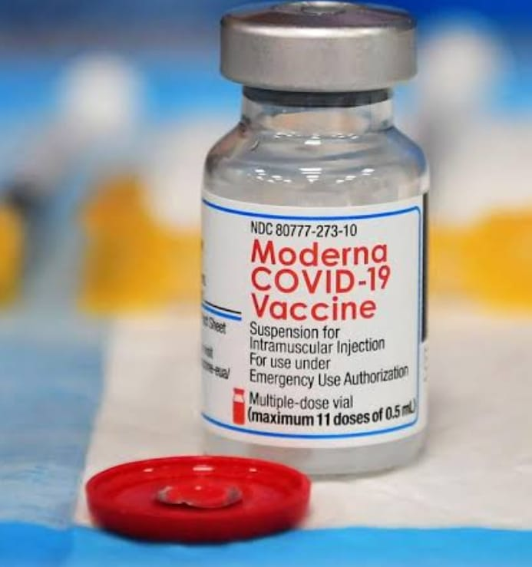
GLOBAL COVID -19 DATA ANALYIS

Slide 3
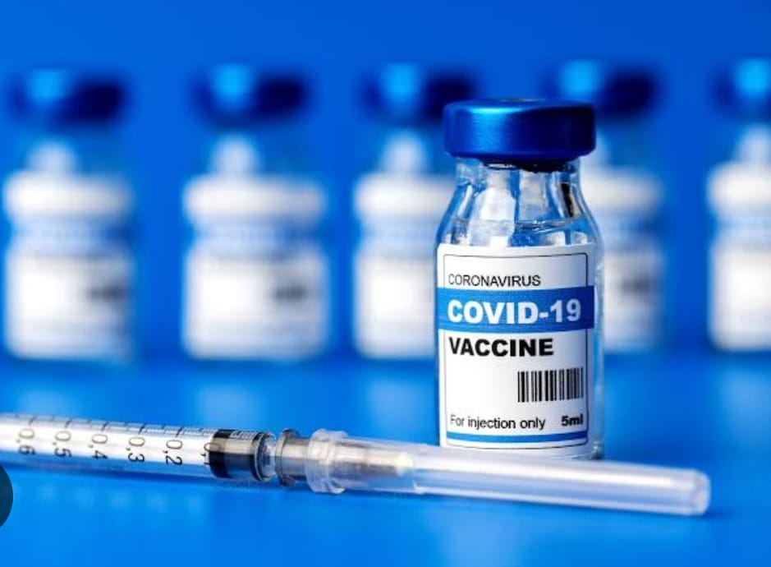
TOPICS
Overview of covid -19
Vaccination Rollout analysis
Recovery Rate Analysis
Impact on Global Economy
Postivity Rate Analysis
Lockdown impact analysis
Hospital infrastructure &
Capacity data
Mental health data analysis
Global misinformation &social media trends

Slide 4
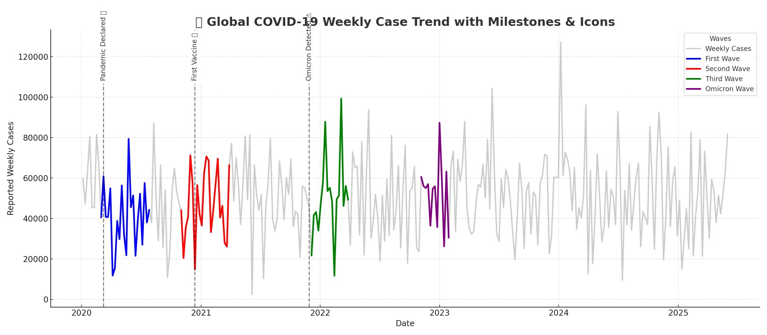
Introduction to covid-19
Covid-19 also known as the coronavirus disease caused by a newly discovered virus called SARS-CoV-2 (Severe Acute Respiratory Syndrome Coronavirus 2). The disease was first identified in whuan, China, in December 2019, and quickly spread across the world,leading to a global pandemic declared by the World health Organization(WHO) on 11 march,2020.
Covid -19 primarily spreads through respiratory droplets when an infected person coughs, sneezes,or breathes. It can also spread by touching surfaces contaminated with the virus and then touching the face, espeacially the mouth,nose or eyes.

Slide 5
Vaccination Rollout Analysis
The vaccination rollout is a critical public health initiative aimed at achieving widespread immunity against infectious diseases, particularly COVID-19. This analysis focuses on the pace, coverage, challenges and impact of the vaccination program.
ROLLOUT PAHSES
Phases 1: Forntline health workers and Essenital services.
Phases 2: elderly (60+yrs) and high- risk individuals.
Phases3: General adult population.
Phases4: Adolescents and Childern (if applicable ).
Booster / Revaccination Campaigns (if applicable).

Slide 6
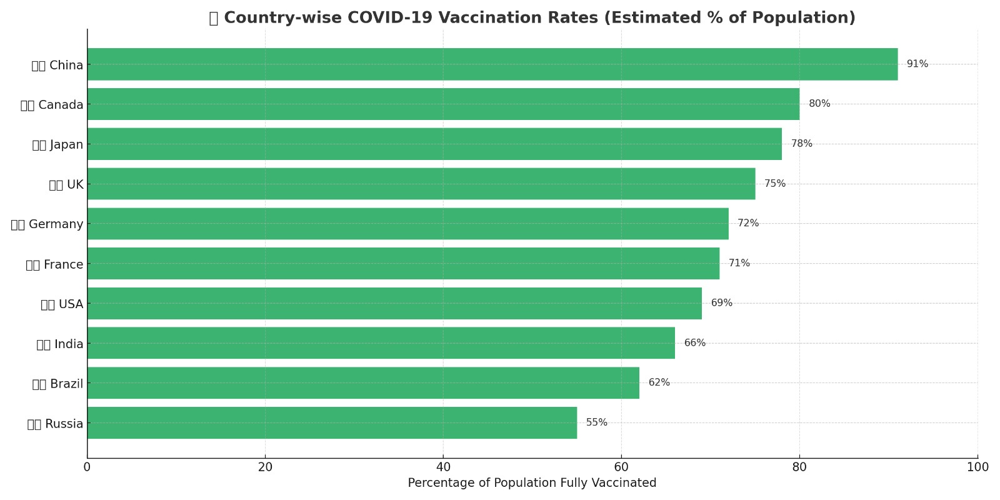

Slide 7
RECOVERY RATE ANALYSIS
Concept: Age-wise COVID-19 Case Distribution Chart
Let’s imagine the following age groups:
0-17, 18-30, 31-45, 46-60, 60+
We'll show 3 bars per age group:
🟦 Active cases
🟩 Recovered cases
🟥 Deceased cases

Slide 8
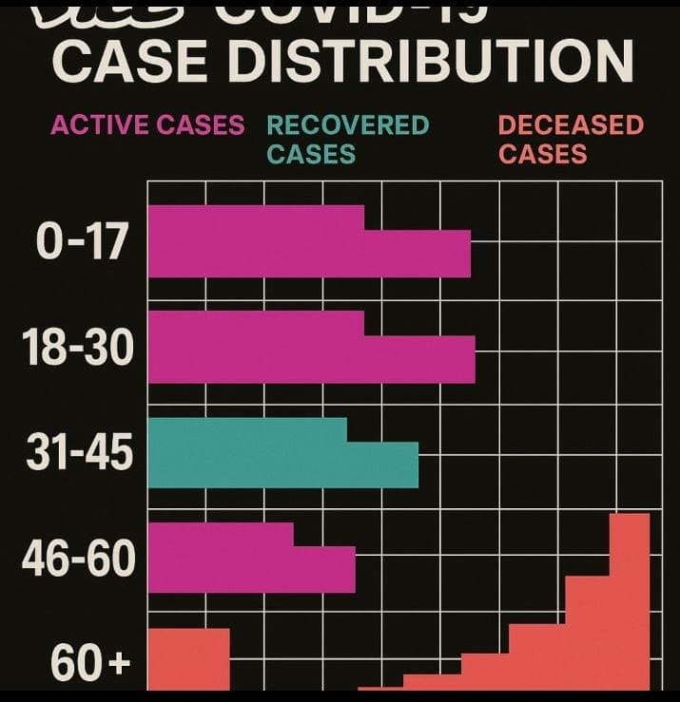
Sample creative Bar chart (concept)

Slide 9
Brief Explanation
Young age group (18-30)
High Active Recovered and cases
Very low death ratio due to ratio due to stronger immunity.
Middle age ( 31 -45 & 46 -60):
Moderate recovery , but silghtly higher fatalities due to comorbidties.
Senior citizens (60+):
Lower recovery , higher deceased cases , especially in males.
Immune system vulnerability shows in higher death ratio.

Slide 10
Impact on Global Economy
1. GDP Drop & Recovery (2020 vs 2021)
In 2020, all countries faced economic contraction.
In 2021, a strong recovery is seen — especially in India (8.7%) and UK (7.4%).
2. Sector-wise Losses The Travel sector faced the highest loss ($935 billion), followed by Retail and Education sectors.
3. Unemployment Rise The USA and Canada saw the sharpest rise in unemployment . India also experienced a significant increase (2.6%).
4. Economic Aid Packages (% of GDP)
Japan (42%) and Germany (39%) offered the largest stimulus packages. India’s aid was about 10% of its GDP.

Slide 11
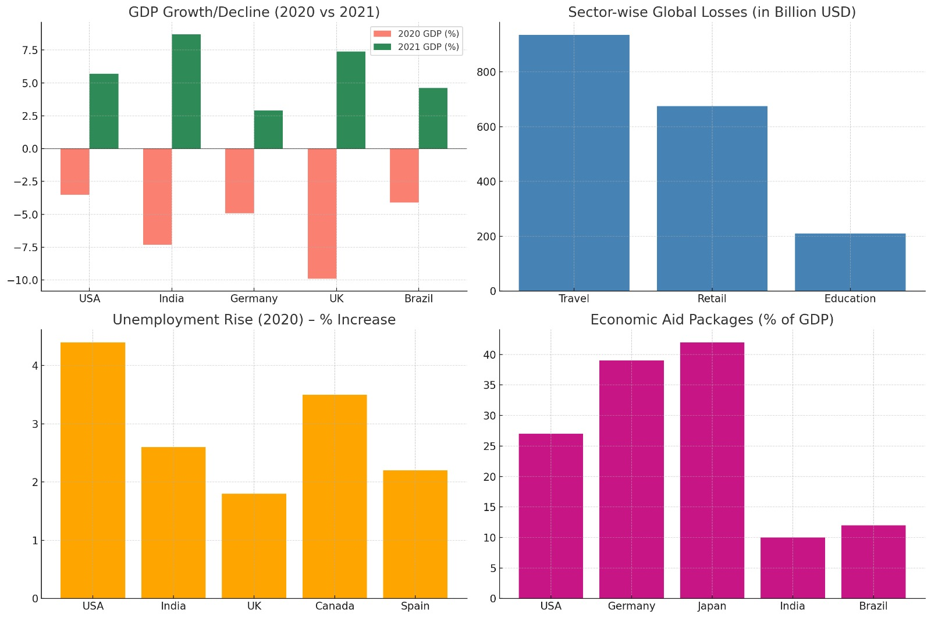
Economic Data Study Chart pack- covering 4 key areas

Slide 12
Postivity Rate Analysis
Postivity rate refers to the percentages of all COVID -19 tests (or the other diesase tests ) that return postive results . It is a key indicator of the diesese transmission, testing adequancy, and potential underreporting.

